Slide 1

“janitor” Package in R
Meadow Monticello
Nick Zywalewski

Slide 2
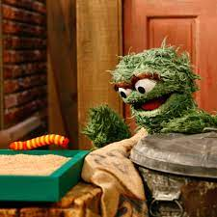
Presentation Outline
Package overview
Our data set
Implementation in R
Takeaways and our experience with data cleaning
OoOOoOo! What’s that?

Slide 3

What is the “janitor” package?
clean_names()
tabyl()
get_dupes()
get_one_to_one()
Published on 12-22 (Meadow’s birthday) -2024 and created by Sam Firke
Cleaning
  Parses, appends, converts symbols, and (adds/removes) spaces
  Removing of empty rows/columns and columns with constant values
  Converting date formats
Exploring
  Search records for duplicates and specific value combinations
  Inspect one-to-one relationships
  Building tables
  Count factor levels

Slide 4
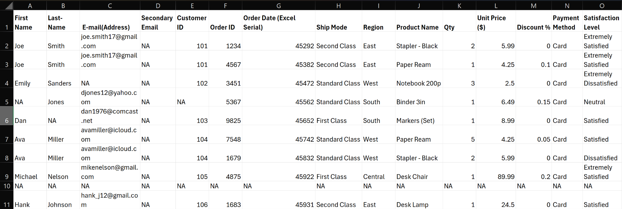
The Data Set

Slide 5

Implementation of Package with Data Set
janitor package be like…

Slide 6
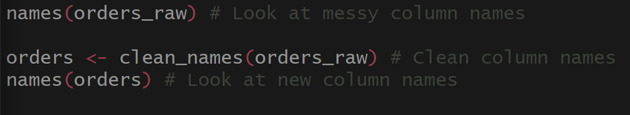
Cleaning: Column Names
This cleans the column names of our dataset, ensuring that there are no funky symbols or spaces in them.
Notice how the output will utilize underscores to fix this.

Slide 7
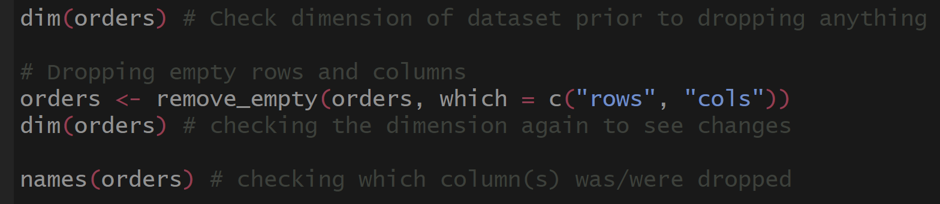
Cleaning: Dropping Empty Rows and Columns
Here, we remove empty rows and columns.
Notice how there is one row and one column that get dropped after this cleaning step.
10X15 → 9X14

Slide 8
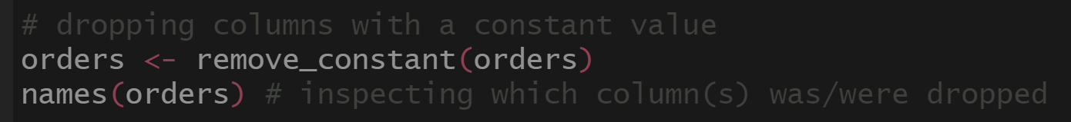
Cleaning: Removing Columns with Constant Values
Since everyone paid with a credit card, notice how “Payment Method” is no longer in our list of column names.

Slide 9
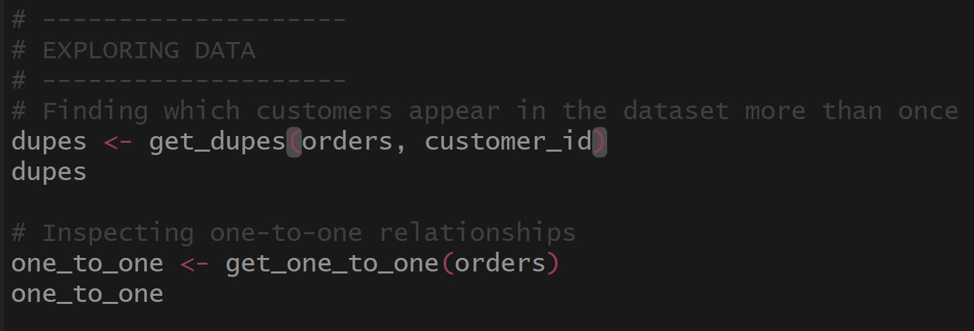
Exploring: Duplicates
Here, we are taking a look at rows that have similar data in them. In this particular example. We are examining which customers placed multiple orders.
Notice how the output allows us to see all of the details in these cases.

Slide 10
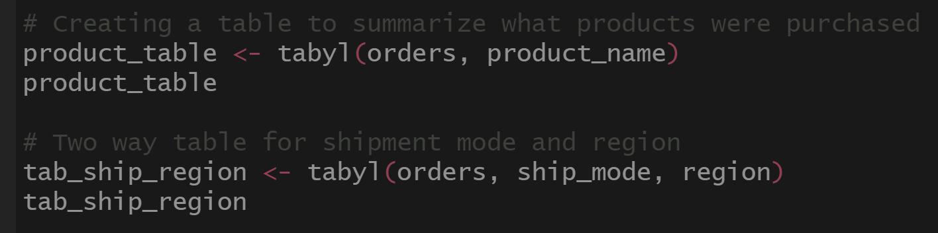
Exploring: Table Creation
Here, we are building tables consistent with what variable(s) we are interested in. One-way and two-way tables help us see relationships between variables and to quickly count frequencies, compare groups, and identify patterns in the data.

Slide 11
Our Experience and Takeaways
DSS 416, Data Wrangling and Visualization
  Fe Y Alegría
DSS 420, Data Mining
DSC 225, Data Science of Sports
MAT 470, Statistics in Research
These classes all dealt with filthy data. Utilizing “janitor” would have helped tremendously. I am curious if there exists similar packages in Python and if so how they might differ.

Slide 12
References
https://cran.r-project.org/web/packages/janitor/index.html
https://cran.r-project.org/web/packages/janitor/vignettes/janitor.html#clean-dataframe-names-with-clean_names
https://www.rdocumentation.org/packages/janitor/versions/2.2.1
https://www.r-bloggers.com/2024/08/top-25-r-packages-you-need-to-learn-in-2024/
Also the “help” function came in handy!

Slide 13

Any questions? Thank you!
Now scram!!!
Oscar the Grouch when the data isn’t clean. JK he loves the grime.

